Slide 2
THE COMPANY
Creature Communication is an End2End Strategic Solution Provider which engages with a plethora of businesses from corporate, local SMEs to Non-Profit organizations and from digital to traditional and institutional arrangements – having a wide array of clients across Bangladesh.

Slide 3
WHAT WE BELIEVE IN
We develop communication strategies, based on insights.
Insights lead us to come up with creative expressions that grab attention.
We define communication excellence by the yardstick of effectiveness and memorability.
While effectiveness addresses the quantitative aspect of a brand’s business, memorability works to create a positive imprint in the heart and mind space of the intended TA.

Slide 4
WHAT WE DELIVER
IDEAS THAT STAND OUT IN A CROWD

Slide 5
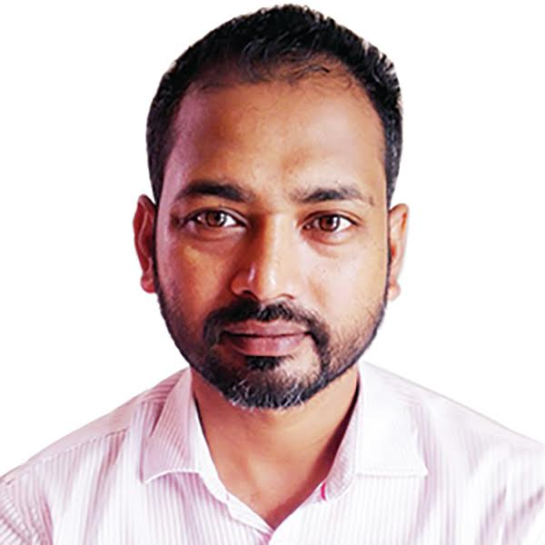
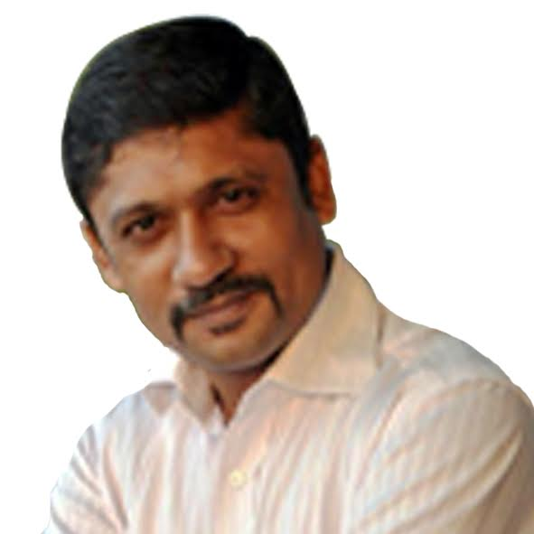
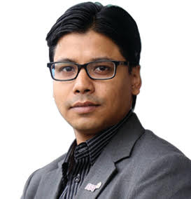
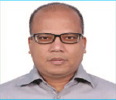
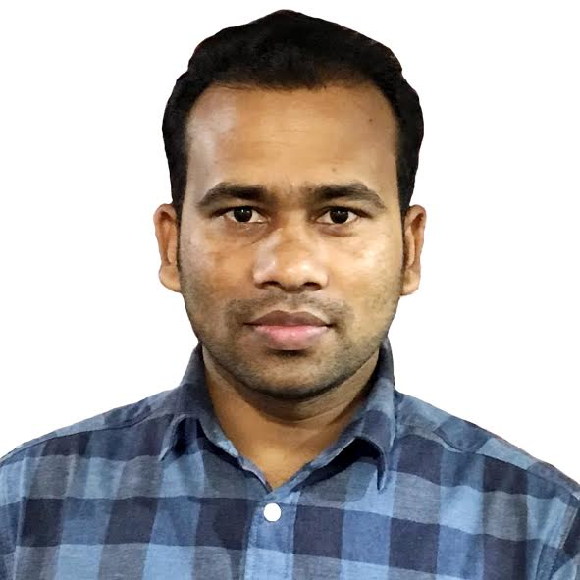
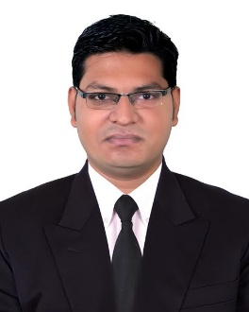
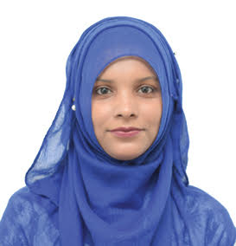
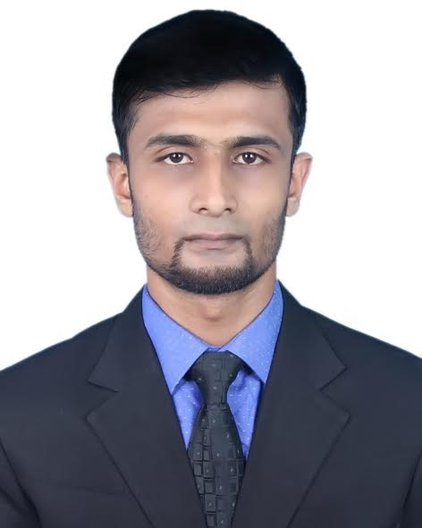
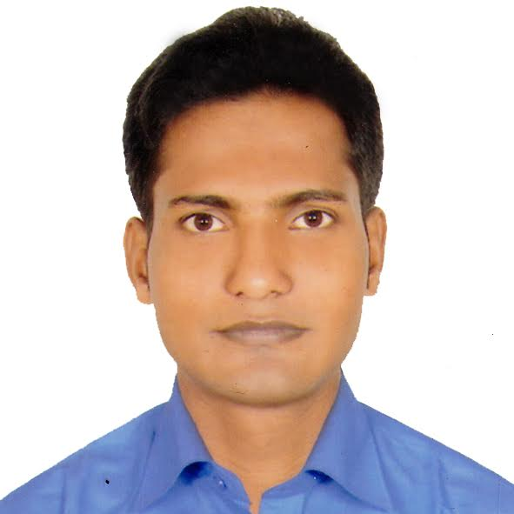
MUSICIANS BEHIND THE CHOIR
Shohel Choudhury
CEO
Uzzal Ahmmed
Head of Business
Abdul Wahed
Head of Strategy
Rahim Sarwar
Head of Operations
Abdur Razzak
Manager, Accounts
Mushfiqur Rahman
Executive, Client Service
Sumya Binta Alam
Executive, Client Service
Mohammad Hasan
Executive, Client Service
Md. Moyazzem
Executive, Office Operations

Slide 6
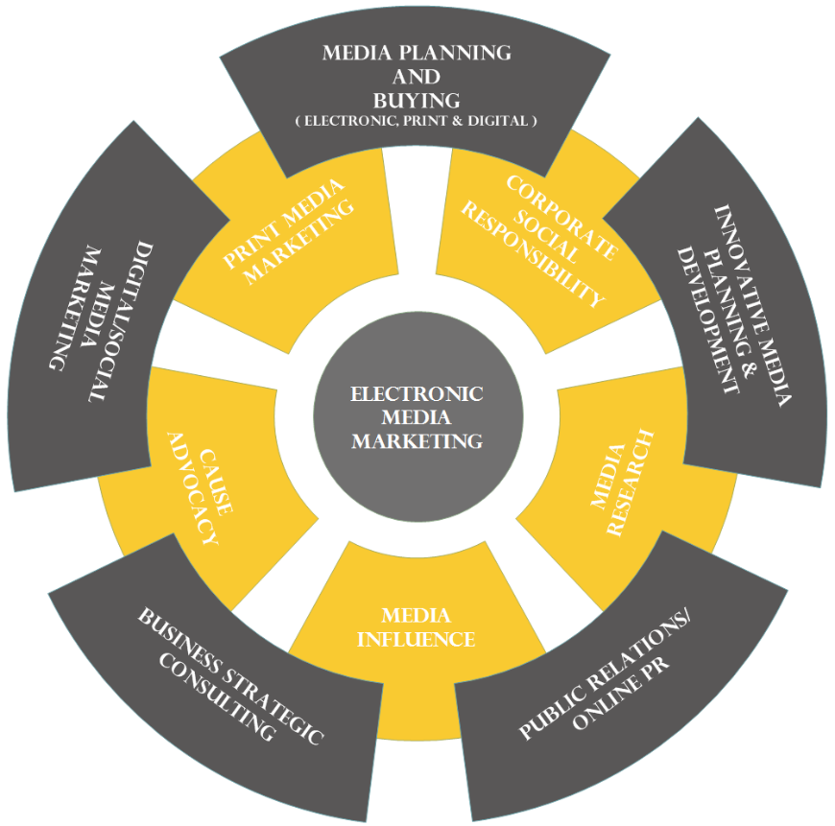
WHAT WE DO

Slide 7
OUR SERVICES
We offer fully customized and integrated services in
Strategic media planning and buying
Innovative marketing communications planning & strategy
Professional media relations & publicity management
Event plan and management
Marketing & media training for your team
Targeted public relations
Digital Marketing and Communications
Corporate communication
Internal communication
Tools development & production

Slide 8
OUR WORK SECTIONS
Strategy & Planning
Strategic communication can help you decide your aims, identify your target audiences and choose the best way to speak directly to people in the way they want to hear from you.
We believe that planned marketing is essential for your success. We can assist you to implement cost effective strategy and planning. If you have a plan, we’ll support you in delivering it; if you don’t, we’ll help you create a plan that works.

Slide 9
OUR WORK SECTIONS (continued…)
Media Management
Media are powerful yet varied channels for sharing key messages with your target audience. Advertising, publicity and positioning can be highly effective when it’s delivered strategically. Bad publicity is never good, full stop.

Slide 10
OUR WORK SECTIONS (continued…)
Publicity & Relationship Building
Our backgrounds on both sides of PR and journalism means we have strategic ideas for best using tactics for reaching your target audience, so you can best decide how to spend your budget wisely.
Positively highlighting your name or business in the news relies on establishing good rapport with media and recurring good news requires effective and professional media relationships. Most businesses don’t have the time, contacts or knowledge to develop media links but when an issue occurs it can make a real difference if you’ve been proactive, or if reacting is the only option you have.

Slide 11
OUR WORK SECTIONS (continued…)
Corporate & Internal Communication
Your brand is reflected in everything your business does, from your logo to the attitude of staff to the bottom line in your annual report. What you decide to say and how you say it is crucial to your marketing and business success, so Creature’s professional copy writers and editors can help mold your brand into words through print and web tools, advertising, newsletters and brochures, policy documents, and all of your internal or external communication.

Slide 12
OUR WORK SECTIONS (continued…)
Events
Creature has extensive experience in coordinating memorable events, from intimate business lunches to major launches, celebrations, conferences or Gala Balls. You can leave the planning and pressure to us and just relax or enjoy the spotlight!

Slide 13
OUR VALUED CLIENTS

Slide 14
WHAT CAN YOU EXPECT WORKING WITH US?
Commitment
Involvement
Enthusiasm
What you see is what you get!!
We take responsibility.
We work as part of the project team.
We do what’s best for the team.
We enjoy doing what I do.
We give 100% to every aspect.
Tenacity
Integrity
Delivery
We believe in doing things right.
We work to get it right from the outset.
We don’t fob off clients or consumers.
We say it like it is.
We know clients want recommendations.
We ensure research delivers them.

Slide 15
WHY US?
Result orientation
Bottom line results are the only things that matter
Reasonable cost
The costs of our services are significantly lower than the value we deliver
Confidentiality
We respect a confidential relationship between us and our clients

Slide 16
HOW CAN YOU GET IN TOUCH?
Address
Haﬁz Mansion (2nd Floor), 33 Kazi Nazrul Islam Avenue, Karwan Bazar, Dhaka-1215
Web
https://www.creaturebd.com/
https://www.facebook.com/creaturecommunication
Contact
Shohel Chowdhury
CEO
+880 1707205090
creaturebd@gmail.com
Uzzal Ahmmed
Head of Business
+880 1716287743
creatureuzzal@gmail.com

Slide 17
FOR YOUR UPCOMING PROJECTS
WE WOULD LOVE TO HEAR FROM YOU!

